Slide 1
Decimal to Number System Conversions
Binary, Octal and Hexadecimal
Class Notes with Examples

Slide 2
Decimal to Binary
Division | Quotient | Remainder
25 ÷ 2 | 12 | 1
12 ÷ 2 | 6 | 0
6 ÷ 2 | 3 | 0
3 ÷ 2 | 1 | 1
1 ÷ 2 | 0 | 1
1 1 0 0 1
Method: Repeatedly divide the decimal number by 2.
Write each remainder.
Read the remainders from bottom to top.

Slide 3
Decimal to Octal
Method: Repeatedly divide the decimal number by 8.
Read remainders from bottom to top.
Division | Quotient | Remainder
125 ÷ 8 | 15 | 5
15 ÷ 8 | 1 | 7
1 ÷ 8 | 0 | 1
1 7 5

Slide 4
Decimal to Hexadecimal
Method: Repeatedly divide the decimal number by 16.
Remainders 10–15 are A–F.
Division | Quotient | Remainder
250 ÷ 16 | 15 | 10 = A
15 ÷ 16 | 0 | 15 = F
F A

Slide 5
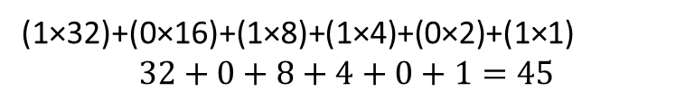
Binary to Decimal Conversion
Definition
Binary to Decimal conversion is the process of converting a base-2 (binary) number into a base-10 (decimal) number.
Steps
Write the positional weights (powers of 2).
Multiply each binary digit by its positional value.
Add all the products.
Binary Digit | 1 | 0 | 1 | 1 | 0 | 1
Power of 2 | 2⁵ | 2⁴ | 2³ | 2² | 2¹ | 2⁰
Value | 32 | 16 | 8 | 4 | 2 | 1
(1×32)+(0×16)+(1×8)+(1×4)+(0×2)+(1×1)
$$32+0+8+4+0+1=45$$

Slide 6
Binary to Octal Conversion
Definition
Convert a binary number into an octal number by grouping 3 bits from the right.
Steps
Group the binary digits into sets of 3 from right to left.
Add leading zeros if necessary.
Convert each group into its octal equivalent.
1101011₂
= 001 101 011
1101011₂ = 153₈

Slide 7
Binary to Hexadecimal Conversion
Definition
Convert a binary number into a hexadecimal number by grouping 4 bits from the right.
Steps
Group the binary digits into sets of 4 from right to left.
Add leading zeros if necessary.
Convert each group into its hexadecimal equivalent.
11111010₂
= 1111 1010
11111010₂ = FA₁₆

Slide 8
Octal to Binary Conversion
Definition
Octal to Binary conversion is the process of converting a base-8 (octal) number into a base-2 (binary) number.
Steps
Replace each octal digit with its 3-bit binary equivalent.
Combine all the binary groups.
Octal | Binary
3 | 011
4 | 100
5 | 101
345₈ = 011100101₂

Slide 9
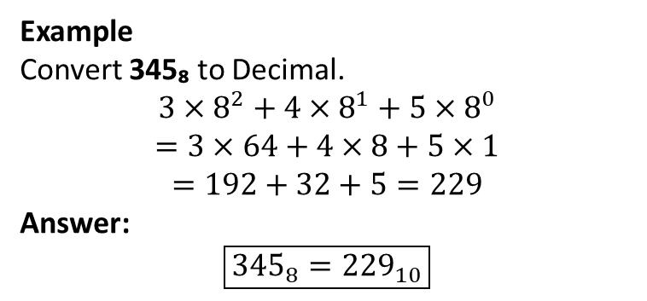
Octal to Decimal Conversion
Definition
Octal to Decimal conversion is the process of converting a base-8 (octal) number into a base-10 (decimal) number.
Example
Convert 345₈ to Decimal.
$$3×8^{2}+4×8^{1}+5×8^{0}$$
$$=3×64+4×8+5×1$$
$$=192+32+5=229$$
Answer:
$$\boxed{{345}_{8}={229}_{10}}$$

Slide 10
Octal to Hexadecimal Conversion
Method
There is no direct conversion. Use:
Octal → Binary → Hexadecimal
Example
Convert 345₈ to Hexadecimal.
Step 1: Octal → Binary
345₈ = 011100101₂
Step 2: Group into 4 bits
0000 1110 0101
0 E 5

Slide 11
Hexadecimal to Binary Conversion
Definition
Hexadecimal to Binary conversion is the process of converting a base-16 (hexadecimal) number into a base-2 (binary) number.
Steps
Replace each hexadecimal digit with its 4-bit binary equivalent.
Combine all the binary groups.
Hex | Binary
2 | 0010
A | 1010
2A₁₆ = 00101010₂

Slide 12
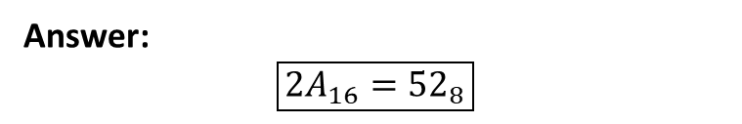
Hexadecimal to Octal Conversion
Method
There is no direct conversion. Use:
Hexadecimal → Binary → Octal
Steps
Convert each hexadecimal digit into 4-bit binary.
Group the binary digits into 3 bits from the right.
Convert each group into an octal digit.
Example
Convert 2A₁₆ to Octal.
Step 1: Hex → Binary
2A₁₆ = 00101010₂
Step 2: Group into 3 bits
000 101 010
Binary | Octal
000 | 0
101 | 5
010 | 2
Answer:
$$\boxed{2A_{16}={52}_{8}}$$

Slide 13
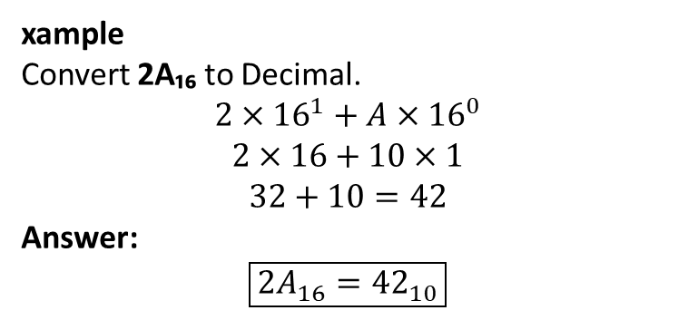
Hexadecimal to Decimal Conversion
Definition
Hexadecimal to Decimal conversion is the process of converting a base-16 (hexadecimal) number into a base-10 (decimal) number.
xample
Convert 2A₁₆ to Decimal.
$$2×{16}^{1}+A×{16}^{0}$$
$$2×16+10×1$$
$$32+10=42$$
Answer:
$$\boxed{2A_{16}={42}_{10}}$$

Slide 14
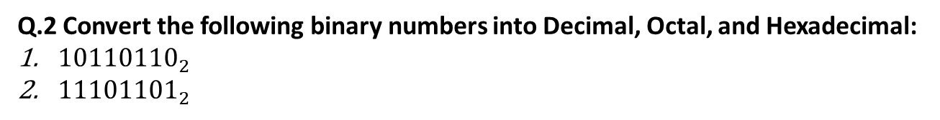
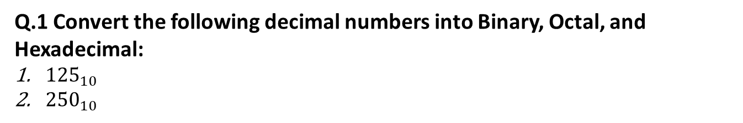
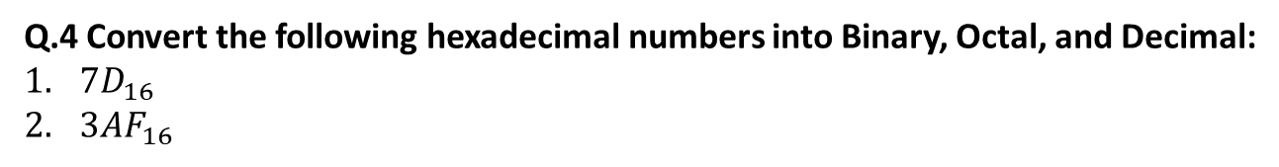
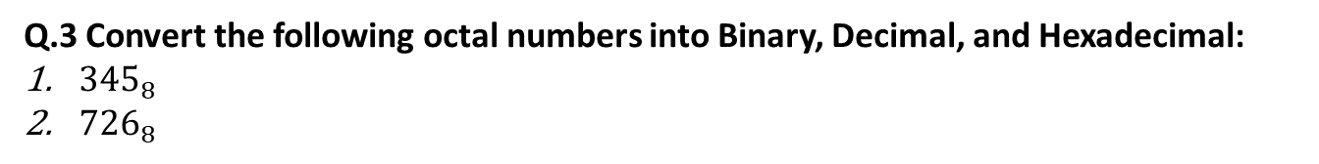
Q.1 Convert the following decimal numbers into Binary, Octal, and Hexadecimal:
${125}_{10}$
${250}_{10}$
Q.2 Convert the following binary numbers into Decimal, Octal, and Hexadecimal:
${10110110}_{2}$
${11101101}_{2}$
Q.3 Convert the following octal numbers into Binary, Decimal, and Hexadecimal:
${345}_{8}$
${726}_{8}$
Q.4 Convert the following hexadecimal numbers into Binary, Octal, and Decimal:
$7D_{16}$
$3AF_{16}$

